Slide 1
Principles of the Software Design
Course for Armenian-French University
Areg Melik-Adamyan
Petr Kurapov

Slide 2
Lecture 9
Towards large systems – Parallelism, Concurrency, Actors

Slide 3
Going Very Large

Slide 4
What is a distributed system?
A distributed system is a collection of autonomous computing elements that appears as a single coherent system to the users.
Collection of autonomous computing units
Consists of heterogeneous nodes acting independently of each other.
Nodes programmed to achieve common goals via exchanging messages.
Single coherent system
A system is coherent if it behaves according to expectations regardless of the where/when/how the interaction with a collection of nodes takes place.

Slide 5
Design goals: when to build a distributed system?
Supporting resource sharing
Provide easy access to a resource (peripherals, storage, data, services, network, etc.). Problem example: collaborative information exchange (e.g., simultaneous files editing) or file-sharing (e.g., BitTorrent).
Transparent resource distribution
Making processes or resources (an object) distribution invisible to the user. Examples include access transparency (e.g., hiding machine architecture or OS details), replication transparency (e.g., Facebook servers), failure transparency (an application does not notice a node failure as it is automatically recovered), etc.

Slide 6
Design goals: when to build a distributed system? (2)
System scalability
At different levels: size (add resources with no performance loss), geographical (resources lay apart, no communication delays), administrative (system is still manageable despite spanning independent administrative orgs) scalability.
Scaling by: hiding communication latencies (e.g., async), partitioning and distribution (e.g., hierarchy of DNS), replication (e.g., caching).
System openness
Components adhere to standards that describe syntax and semantics of services’ interfaces. Specifications must be complete (enough information for implementation) and neutral (specification does not prescribe what an implementation should look like).
Interoperability (different implementations can co-exist), portability (can an application developed for system A run on system B), and extensibility (system can be configured out of different components, possibly, from different vendors).

Slide 7
Common false assumptions
Formulated by Peter Deutsch and James Gosling (Sun Microsystems), a list of flawed assumptions people make when creating their first distributed system:
The network is reliable
The network is secure
The network is homogeneous
The topology doesn’t change
Latency is zero
Bandwidth is infinite
Transport cost is zero
There is one administrator

Slide 8
Introduction to Actor Model
The Actor Model is a conceptual framework for dealing with concurrent computation in distributed systems.
Originally developed in the 1970s by Carl Hewitt, Peter Bishop, and Richard Steiger, the Actor Model has gained renewed relevance in the era of multicore processors and cloud computing.
It provides a robust method for managing state, ensuring fault tolerance, and achieving high levels of concurrency.

Slide 9
What is the Actor Model?
The Actor Model is a mathematical model of concurrent computation that treats “actors” as the universal primitives of computation. An actor is a computational entity that, in response to a received message, can perform the following actions:
Send a finite number of messages to other actors.
Create a finite number of new actors.
Designate the behavior to be used for the next message it receives.

Slide 10
Historical context and origin
The Actor Model was first proposed in 1973 by Carl Hewitt, along with Peter Bishop and Richard Steiger, as a conceptual model for artificial intelligence.
Its creation was motivated by the need to handle concurrent operations more effectively in distributed systems and parallel computing environments.
Over the years, the Actor Model has influenced the development of numerous programming languages and frameworks, providing a basis for efficient and reliable concurrent processing.

Slide 11
Key characteristics of Actors
Encapsulation: Actors encapsulate both state and behavior. Each actor maintains its own private state, which is not directly accessible by other actors. This encapsulation ensures that state changes are controlled and predictable, reducing the complexity associated with shared mutable state.
Message passing: Actors communicate exclusively through asynchronous message passing. When an actor sends a message to another actor, the message is placed in the recipient’s mailbox. The recipient processes each message sequentially, which simplifies concurrency management and avoids issues like race conditions.
State management: Actors manage their own state, updating it in response to incoming messages. The state of an actor can only be changed by the actor itself, in a controlled manner. This isolation of state helps maintain consistency and integrity within the system, even when multiple actors are operating concurrently.

Slide 12
How the Actor Model works
The Actor Model operates on a simple yet powerful premise: actors are the fundamental units of computation, and they interact solely through asynchronous message passing. This section delves into how actors function, interact, and manage their lifecycle, ensuring effective concurrency and isolation.

Slide 13
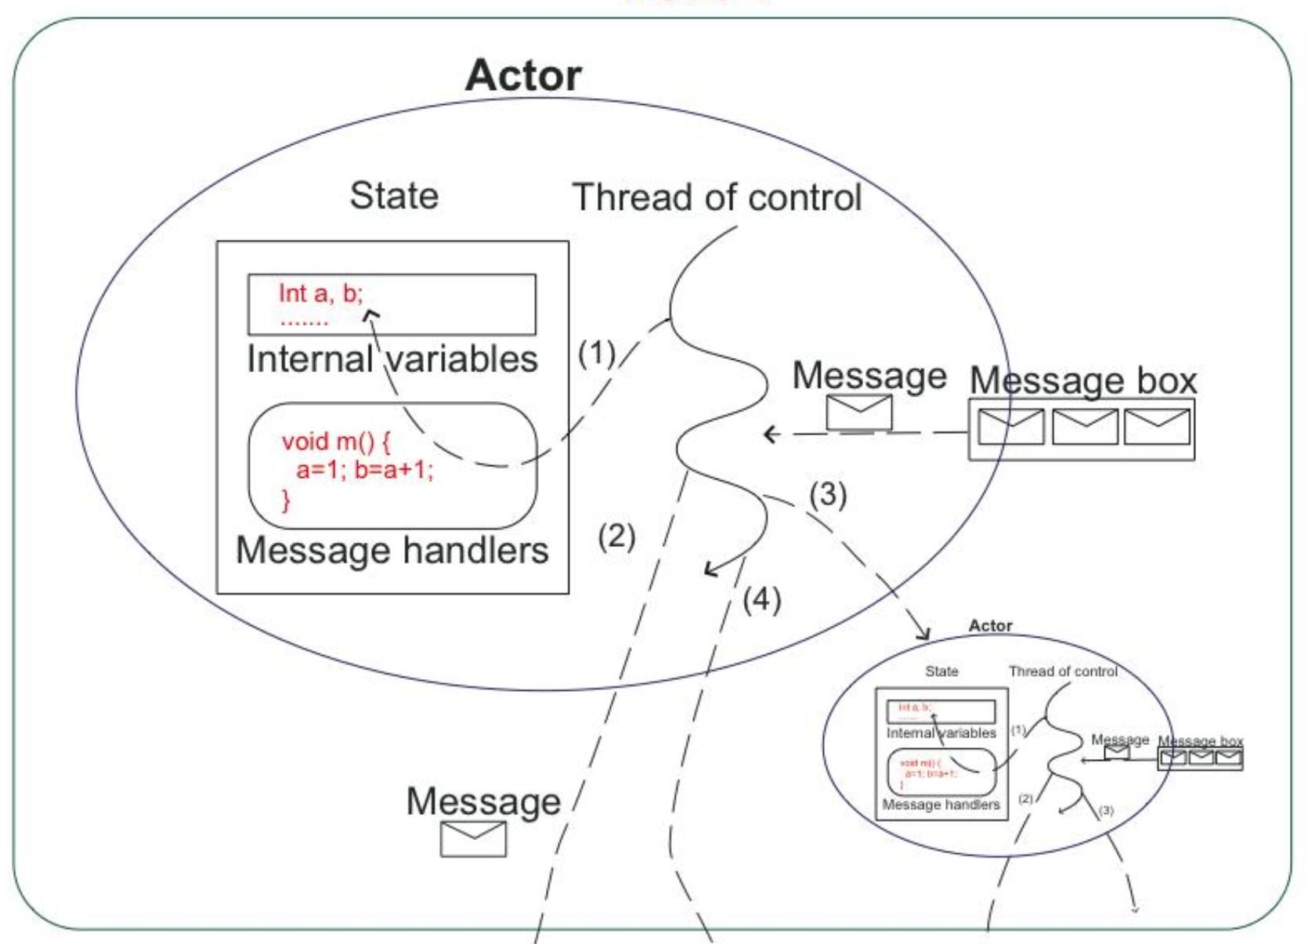
Explanation of Actors and their behavior
Actors are autonomous computational entities that encapsulate state and behavior. Each actor can:
Receive messages: Actors wait for messages sent by other actors. Each message triggers a specific behavior, allowing the actor to perform actions based on the message content.
Send messages: Actors communicate by sending messages to other actors. These messages are processed asynchronously, enabling non-blocking interactions.
Create new actors: To distribute workload or manage tasks more effectively, actors can create new actors dynamically.
Define future behavior: After processing a message, an actor can update its behavior, determining how it will respond to future messages.

Slide 14
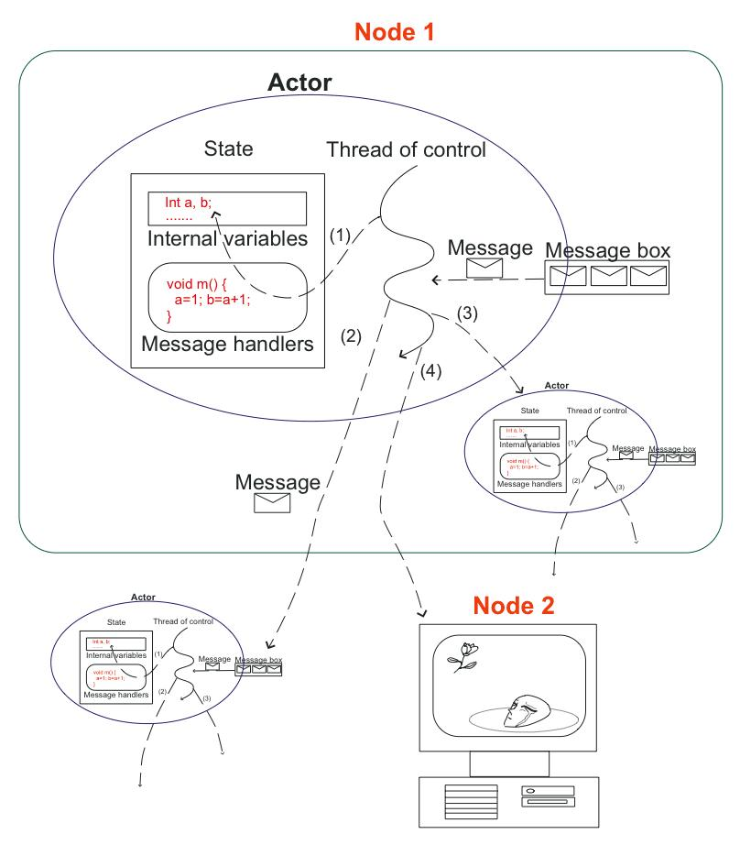
Interaction between actors
Message passing is the cornerstone of the Actor Model. Here’s how it works.
Asynchronous communication: When an actor sends a message to another actor, it does not wait for a response. The message is placed in the recipient’s mailbox, and the sender continues its operations. This non-blocking communication ensures high responsiveness and efficiency.
Mailboxes: Each actor has a mailbox (or message queue) where incoming messages are stored. Actors process messages sequentially, ensuring one message is handled at a time, which simplifies concurrency management.
Decoupling: Message passing decouples the sender and receiver, allowing them to operate independently. This decoupling is crucial for building scalable and fault-tolerant systems.

Slide 15
Lifecycle of an Actor
Actors go through a well-defined lifecycle.
Creation: An actor is created by another actor, which initializes its state and behavior. The creating actor often assigns a unique identifier or address to the new actor, allowing others to communicate with it.
Behavior: The behavior of an actor defines how it processes incoming messages. This behavior can be static (unchanging) or dynamic (modifiable based on messages received). After processing a message, an actor can choose to change its behavior, effectively evolving over time.
Termination: An actor can be terminated when it completes its tasks or encounters an unrecoverable error. Termination involves releasing resources and notifying other actors, if necessary. Proper handling of actor termination is essential for maintaining system stability.

Slide 16
Concurrency and isolation in the Actor Model
Concurrency and isolation are inherent strengths of the Actor Model.
Concurrency: Since actors process messages independently and asynchronously, they can run concurrently without interfering with each other. This natural concurrency makes the Actor Model well-suited for parallel and distributed computing environments.
Isolation: Each actor manages its own state, ensuring no shared mutable state between actors. This isolation prevents common concurrency issues like race conditions and deadlocks. By confining state changes within individual actors, the model ensures consistency and predictability.

Slide 17
Benefits of the Actor Model
Scalability and concurrency management
The Actor Model’s design inherently supports scalability and efficient concurrency management:
Natural concurrency: Actors operate independently and process messages asynchronously. This independence allows multiple actors to run concurrently without the risk of interference, effectively utilizing multi-core processors and distributed systems.
Scalability: Since actors can create new actors dynamically, workloads can be distributed across many actors, facilitating horizontal scaling. This makes it easier to build systems that can handle increasing loads by simply adding more actors or deploying them across more nodes.
Load balancing: Actors can be distributed across different machines or processors, allowing for efficient load balancing. This helps in evenly distributing the computational load and avoiding bottlenecks.

Slide 18
Benefits of the Actor Model (2)
Fault tolerance and resilience
The Actor Model enhances fault tolerance and resilience through its architecture:
Isolation: Each actor is an isolated unit of computation with its own state. If an actor fails, its failure is contained, preventing it from affecting other actors. This isolation contributes to system stability.
Supervision strategies: Actors can be organized in a hierarchical structure where parent actors supervise child actors. If a child actor fails, the parent actor can decide on appropriate recovery actions, such as restarting the failed actor, escalating the error, or stopping the actor. This structured supervision model enhances the system’s ability to recover from failures gracefully.
Error handling: The asynchronous message-passing mechanism allows the system to continue processing other messages even if some actors encounter errors. This non-blocking nature ensures that parts of the system remain operational despite individual actor failures.

Slide 19
Benefits of the Actor Model (3)
Simplified reasoning about concurrent systems
The Actor Model simplifies the development and reasoning of concurrent systems:
Encapsulation: Actors encapsulate state and behavior, reducing the complexity associated with shared state and synchronization mechanisms like locks and semaphores. This encapsulation makes it easier to reason about the system’s behavior.
Sequential message processing: Since actors process one message at a time, developers can focus on the logic for individual messages without worrying about concurrent access to shared data. This sequential processing simplifies debugging and testing.
Modularity: The Actor Model promotes modular design by encouraging the decomposition of complex systems into smaller, independent actors. This modularity enhances code maintainability and flexibility, making it easier to update and extend the system.

Slide 20
Real-world scenarios where the Actor Model excels
The Actor Model is particularly well-suited for various real-world applications, including:
Distributed systems: Systems that need to scale across multiple machines, such as distributed databases and microservices architectures, benefit from the Actor Model’s scalability and fault tolerance.
Real-time applications: Applications requiring real-time processing, like telecommunications systems and financial trading platforms, leverage the Actor Model’s efficient concurrency management to handle high volumes of transactions with low latency.
IoT systems: Internet of Things (IoT) applications, which involve numerous devices communicating asynchronously, can use actors to manage the complexity and ensure reliable message processing.
Gaming and simulation: In gaming and simulation environments, actors can represent individual game entities or simulation components, allowing for scalable and concurrent processing of actions and events.
Reactive systems: The Actor Model aligns well with the principles of reactive systems, providing responsive, resilient, elastic, and message-driven architectures ideal for building robust and adaptive applications.

Slide 21
Erlang
Erlang is a functional programming language designed for building highly concurrent, distributed, and fault-tolerant systems. It was developed by Ericsson for telecommunications applications and has become a go-to language for systems requiring high availability.
Lightweight processes: Erlang’s processes are lightweight and isolated, making it easy to spawn millions of processes.
Fault tolerance: With built-in support for supervision trees, Erlang provides robust error recovery mechanisms.
Hot code swapping: Erlang allows code to be changed without stopping the system, enabling continuous operation.
Example use cases
Telecommunications: Erlang powers systems like the AXD301 ATM switch, handling millions of calls per second.
Messaging systems: WhatsApp uses Erlang to manage its vast messaging infrastructure.
Databases: CouchDB, a NoSQL database, utilizes Erlang for its concurrent and distributed capabilities.

Slide 22
Elixir
A functional, concurrent, and fault-tolerant programming language built on the Erlang VM (BEAM). It maintains Erlang’s strengths while providing modern syntax and tooling.
Concurrency: Leveraging the Erlang VM, Elixir can handle millions of concurrent connections.
Scalability: Elixir’s lightweight processes and efficient message passing enable scalable applications.
Metaprogramming: Elixir supports macros, allowing developers to extend the language’s capabilities.
Example use cases
Web applications: Phoenix framework, built with Elixir, is known for its speed and scalability in web applications.
Telecom: Elixir is used in telecommunication systems requiring high concurrency and reliability.
IoT: Nerves framework allows Elixir to run on embedded devices, making it suitable for IoT applications.

Slide 23
Pony
Pony is an object-oriented, actor-model-based programming language designed for performance and safety. It emphasizes type and memory safety, along with high performance.
Type safety: Pony’s type system guarantees memory safety and prevents data races.
Garbage collection: It employs an efficient garbage collector optimized for low-latency applications.
High performance: Pony’s actors are designed to minimize overhead, making it suitable for performance-critical applications.
Example use cases
Finance: Pony is used in financial systems where high performance and safety are crucial.
High-frequency trading: Its performance characteristics make Pony suitable for high-frequency trading applications.
Concurrent systems: Any application requiring safe and efficient concurrency can benefit from Pony’s actor model.

Slide 24
Akka for Scala and Java
A toolkit and runtime for building highly concurrent, distributed, and resilient message-driven applications. It is primarily used with Scala and Java.
Concurrency: Akka’s actor-based model provides an abstraction for writing concurrent and distributed applications.
Fault tolerance: Akka includes supervision strategies that allow actors to recover from failures.
Clustered systems: Akka Cluster extends Akka’s capabilities to distributed systems, supporting remote communication and fault tolerance.
Streams: Akka Streams provides a powerful and flexible way to handle streaming data with backpressure.
Example use cases
Web services: Akka is used to build scalable web services and APIs, handling high volumes of requests with ease.
Financial systems: Its resilience and scalability make it ideal for financial trading platforms.
IoT applications: Akka’s ability to handle massive concurrency is beneficial for IoT systems that process large amounts of data from numerous devices.

Slide 25
Orleans for .NET
A cross-platform framework for building distributed, high-scale applications in .NET. It abstracts the complexities of building concurrent and distributed applications.
Virtual actors: Orleans introduces the concept of virtual actors, which simplifies the actor lifecycle management.
Scalability: Orleans automatically distributes actors across a cluster and scales them as needed.
Fault tolerance: Built-in support for actor state persistence and recovery.
Ease of use: The framework integrates seamlessly with the .NET ecosystem, making it accessible to .NET developers.
Example use cases
Gaming: Orleans was initially developed by Microsoft Research for use in the cloud-based services of the Halo game franchise.
IoT: Used in IoT platforms to manage and process data from a multitude of sensors and devices.
Cloud services: Ideal for building scalable and resilient cloud services and microservices.

Slide 26
Ray for Python
Ray is a distributed execution framework for Python, designed for machine learning and AI applications. It simplifies the development of parallel and distributed applications.
Flexible APIs: Ray provides simple APIs to scale Python code from a single laptop to a cluster.
Actor model: Supports an actor-based model for stateful computations.
Task parallelism: Allows the parallel execution of tasks across a cluster of machines.
Integration with ML libraries: Integrates seamlessly with popular machine learning libraries like TensorFlow and PyTorch.
Example applications
Machine learning: Ray is widely used in machine learning workflows for training and hyperparameter tuning. E.g., ChatGPT training.
Data processing: Suitable for large-scale data processing tasks requiring distributed computation.
Reinforcement learning: Its ability to handle massive parallelism makes it ideal for reinforcement learning experiments.

Slide 27
Case studies and real-world examples
Telecommunications
Erlang/OTP: Originally designed for the telecom industry, Erlang powers large-scale systems like telephone exchanges. Ericsson’s AXD301 switch is a notable example, handling millions of calls simultaneously with high reliability.
Gaming
Halo 4: Microsoft’s Orleans framework was used to build the cloud services for Halo 4. It managed millions of concurrent players by distributing game state across a cluster of servers, ensuring seamless and scalable gameplay.
Financial services
Credit Suisse: Uses the Akka framework to handle high-frequency trading and risk analysis. The Actor Model helps in processing large volumes of transactions with low latency and high reliability.

Slide 28
BACKUP

